Slide 1
Market Basket Analysis

Slide 2
Project By:
Aanshi Patwari
Dipika Pawar
Miracle Rindani

Slide 3
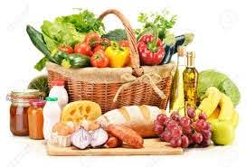
The Dataset
This data belongs to a bakery called "The Bread Basket", located in Edinburgh, Scotland. This bakery presents a refreshing offer of Argentine and Spanish products.
It is collected between 30/10/2016 to 09/04/2017, i.e., roughly 5½ months.
Dataset comprises of:
21293 records
9684 transactions
This dataset is available on Kaggle:
Market Basket Analysis

Slide 4
Data Dictionary

Slide 5
Attributes
The dataset consists of 4 features or attributes:
Feature
Type
Information
1
Date
Categorical
(DateTime)
Date of transaction
YYYY-MM-DD format
Values from 30/10/2016 to 09/04/2017
2
Time
Categorical
(DateTime)
Time of particular transaction
HH:MM:SS format
3
Transaction
Quantitative
Transaction number
Same value means the items are bought by same person
4
Item
Categorical
Name of the item that is bought
Total 94 different values

Slide 6
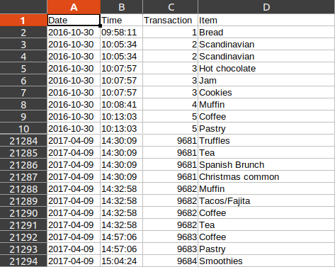
Dataset File

Slide 7
Data
Cleaning

Slide 8
Cleaning
Finding any empty cells in the data table(no empty cell found)
Finding the presence of null values (786 found)
Removing the null value rows (20507 rows in the table)
As the transactions for the months of October and the April are not a whole they are removed from the table for considering the monthly transactions.
Checking that the transaction values are non-negative.

Slide 9
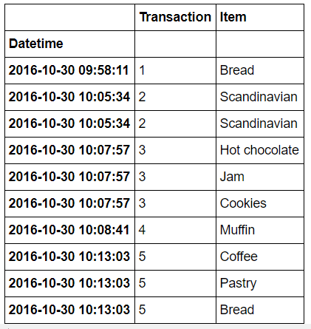
Preprocessing/Transformation
Merging the date and time attributes and forming a datetime attribute
Datetime attribute type is changed to datetime64 which will be useful in plotting time series charts.

Slide 10
Data
Analysis and
Visualisation

Slide 11
Tools and Technologies
Python (Colab)
Orange
Libraries
MLxtend
Matplotlib
Numpy
Pandas

Slide 12
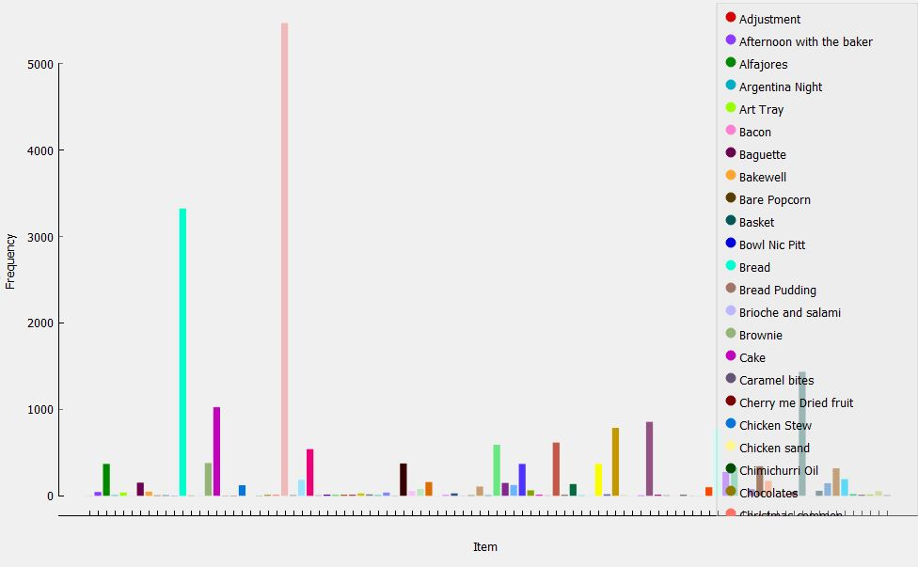
Distribution Plot

Slide 13
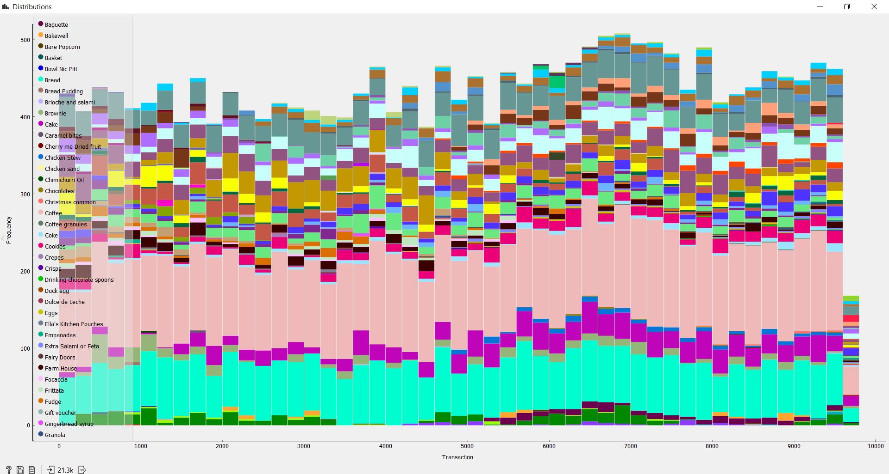
Distribution Plot

Slide 14
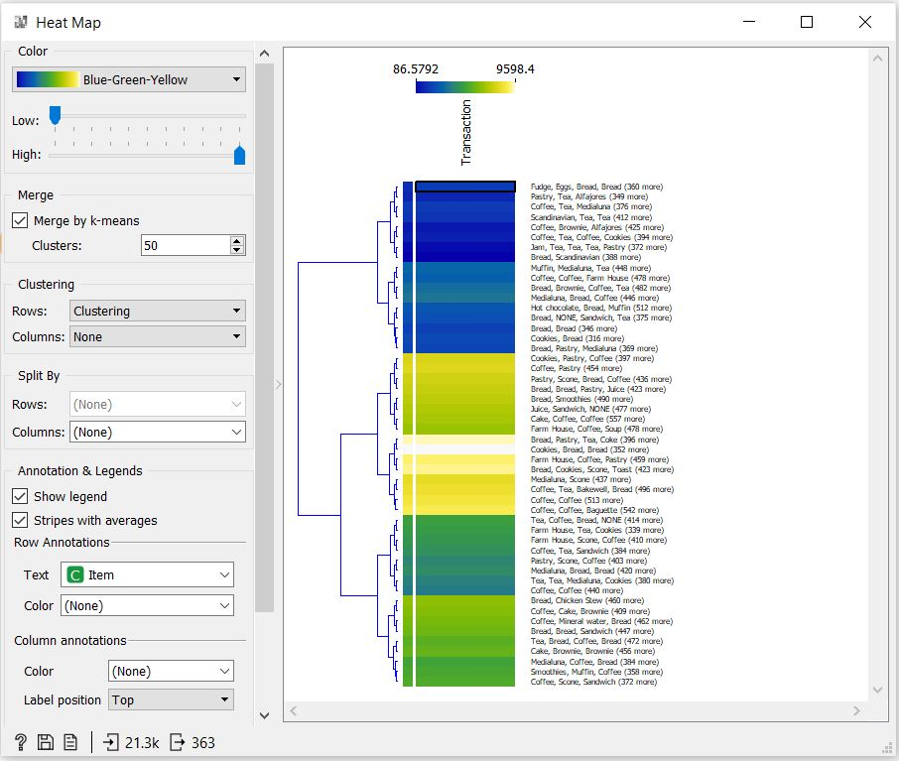
Heat Map

Slide 15
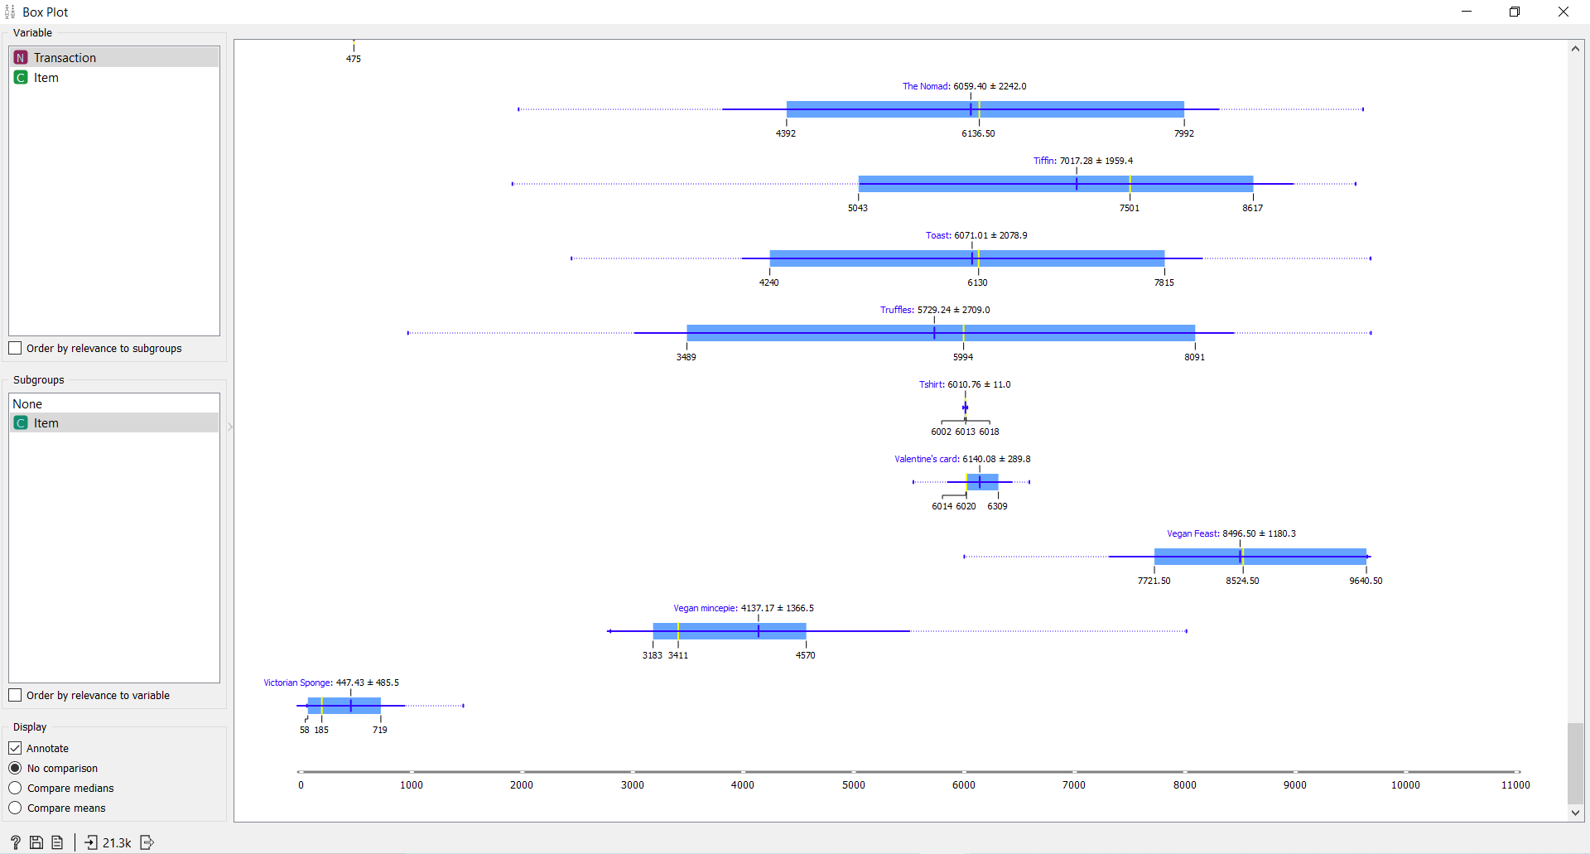
Box Plot

Slide 16
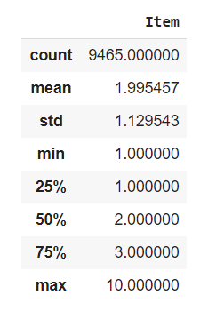

Total sale/transaction details

Slide 17
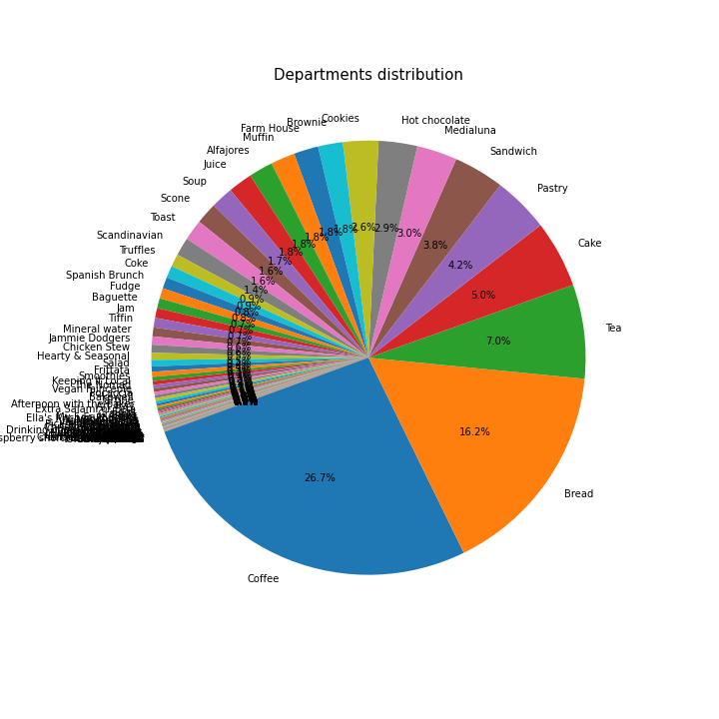
Distribution Plot-Pie Chart
It can be seen that Coffee (26.7%) is the best-selling item in the bakery, follow by Bread (16.2%) and Tea (7.0%).

Slide 18
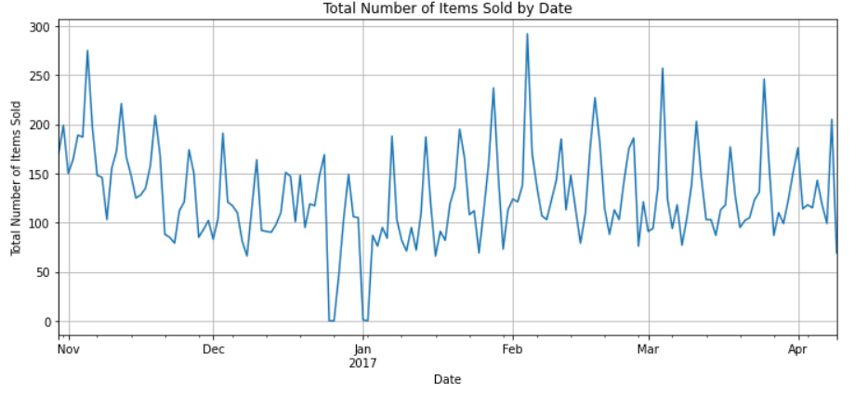
Total Date-wise Distribution
Total Number of Items Sold by Date fluctuates a lot throughout the 159 days of data

Slide 19
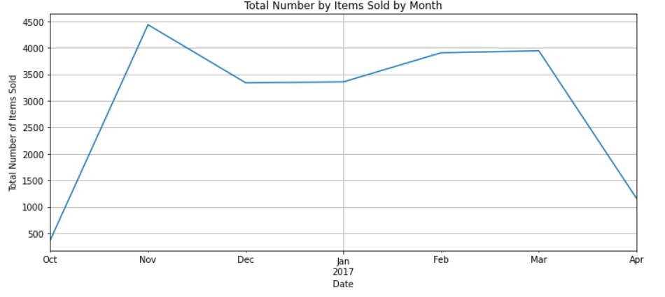
Total Month-wise Distribution

Slide 20
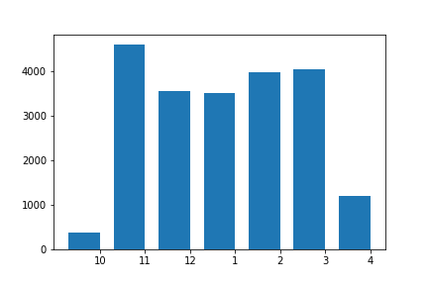
Month-wise Transactions
Given that the beginning month (October 2016) and ending month (April 2017) are not full month, the total number of items sold by month for the five full month between November 2016 to March 2017 does not fluctuate too much.

Slide 21
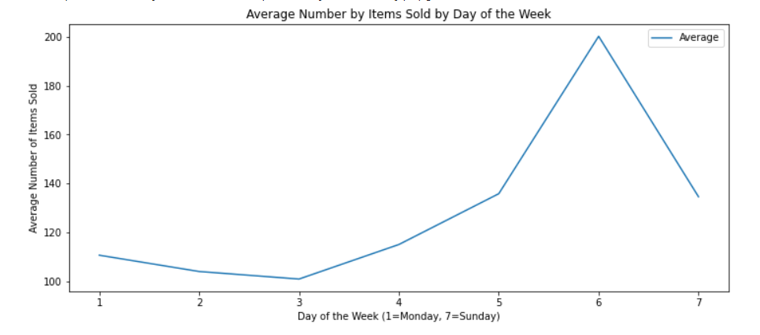
Average Weekly Distribution
Saturday is the busiest day of the week with the highest sales (~200 items) while Wednesday is the quietest day with the lowest sales (~101 items).
Notes:
This is an interesting insight, the owner of the Bakery should launch some promotion activities to boost up sales in the middle of the week when sales are slowest.

Slide 22
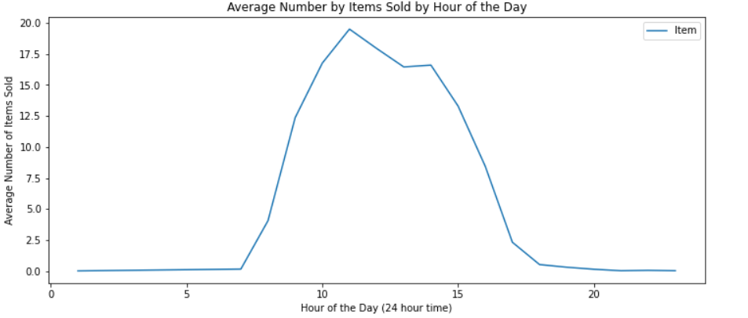
Average Daily Distribution
Sales starts to pick up from 8am, till the busiest hour of the day at 11am, then slowly drops till the late afternoon.
Notes:
It can be observed that most of the sales transactions took place during the lunch hours of the day

Slide 23
Association Rule Mining

Slide 24
Apriori Algorithm
Use of MLxtend library
Group the items and the transactions for the count of items
One-hot encoding of the data items for the transactions
Then performing one-hot encoding for values according to the count of items for a given transaction
After encoding, set the apriori function
Generate the frequent itemset
Find the association rules based on support value
Use of minimum support-threshold = 0.01

Slide 25
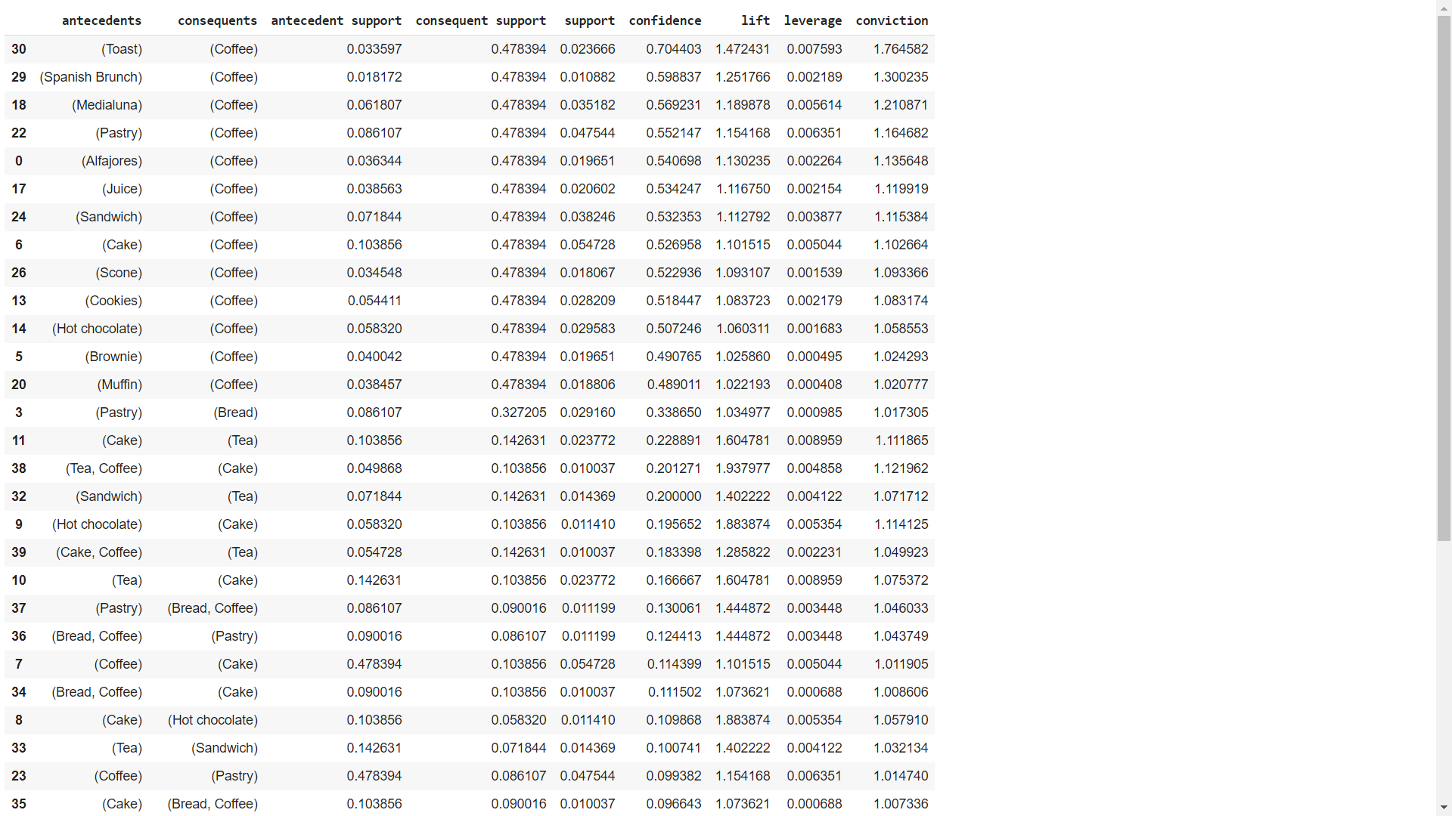
Association Rule Outcomes
(min support = 1%)
This are the generated rules with their corresponding support, confidence and lift with minimum threshold for lift at 1 sorted by descending confidence value.

Slide 26
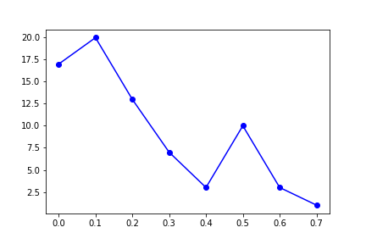
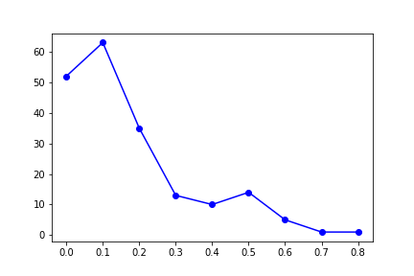
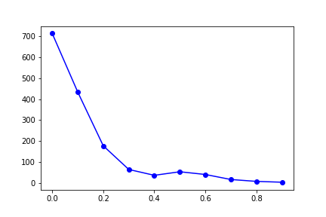
Apriori Algorithm
(no. of values → confidence )
Min Support:
1% 0.5% 0.1%

Slide 27
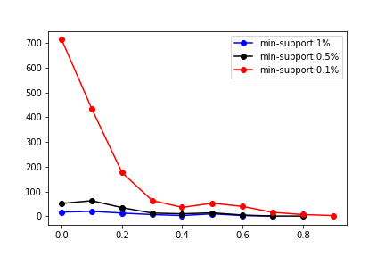
Apriori Algorithm

Slide 28
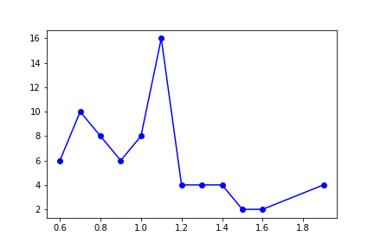
Apriori Algorithm
(no. of rules(values) → lift)
(1% min-support)
The lift value of greater than 1, it shows that the purchase of second item is indeed influenced by the purchase of first item rather than independent purchase of second item.

Slide 29

THANK YOU!!

